Slide 1
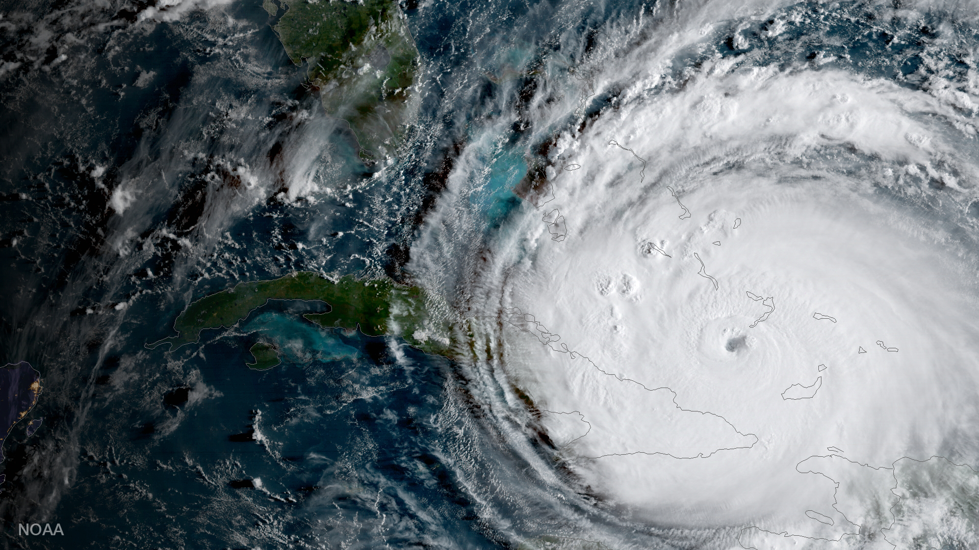
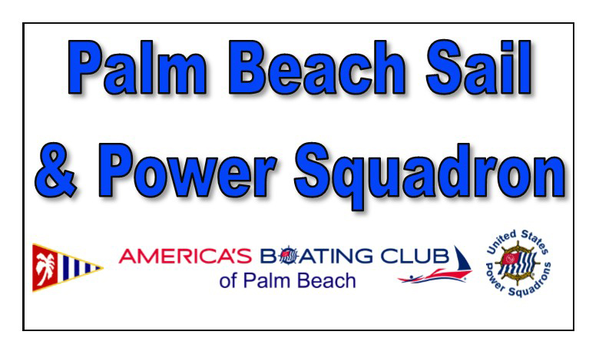
Hurricane Preparation for Boaters
Presented by:
Notes:
Welcome to the Hurricane and Boats seminar. While this seminar focuses on hurricane prone areas the information has wider application since every recreational boating area has severe weather creating short term conditions similar to hurricanes in intensity. This seminar was a joint effort with Escambia County, Florida, Marine Resources Division.

Slide 2
First, let’s get our priorities straight: People Homes Businesses Boats
Hurricane Preparation for Boaters
Take care of your boat only after you’ve taken care of the 1st three
And only if you can do so safely
Notes:
Welcome to the Hurricane and Boats seminar. While this seminar focuses on hurricane prone areas the information has wider application since every recreational boating area has severe weather creating short term conditions similar to hurricanes in intensity. This seminar was a joint effort with Escambia County, Florida, Marine Resources Division.

Slide 3
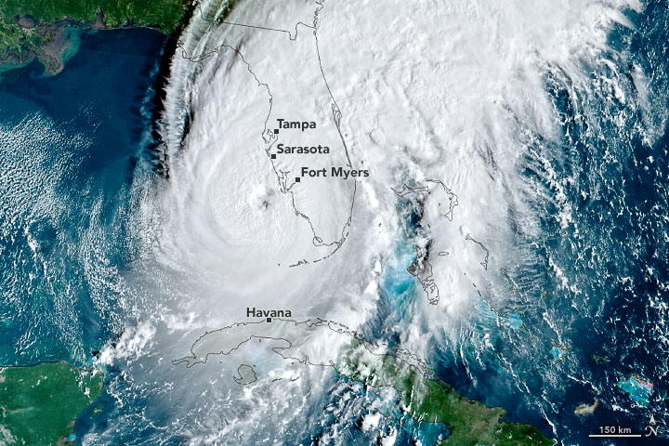
Ian, Sept. 28-30, 2022
Category 4
Winds: 150 mph
Storm Surge: 13.8+ ft
100+ Deaths
$113B damages
Notes:
What starts a a relatively minor storm can (and probably will) become a major threat.
Ivan was a category 2 storm that developed rapidly, passed through category 4 and made landfall as a category 3 storm causing major damage in Florida and Alabama.
In the case of Katrina the most recent analysis is that Katrina had a unique twin eye-wall structure. Simply the affected got hit twice as the storm passed.
NHC forecast is for continuing active hurricane seasons for the next decade.

Slide 4
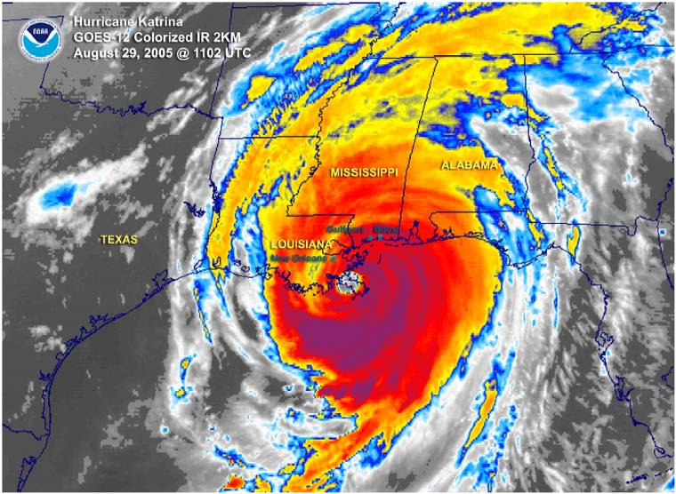
Hurricane Katrina 2005
Category 3
Winds: 125 mph
Storm Surge: 11.5+ ft
1833 Deaths
$108B damages

Slide 5
Hurricane Ivan 2004
Category 3
Winds: 120 mph
Storm Surge: 10 - 15 ft
123 Deaths
$20.5B damages

Slide 6
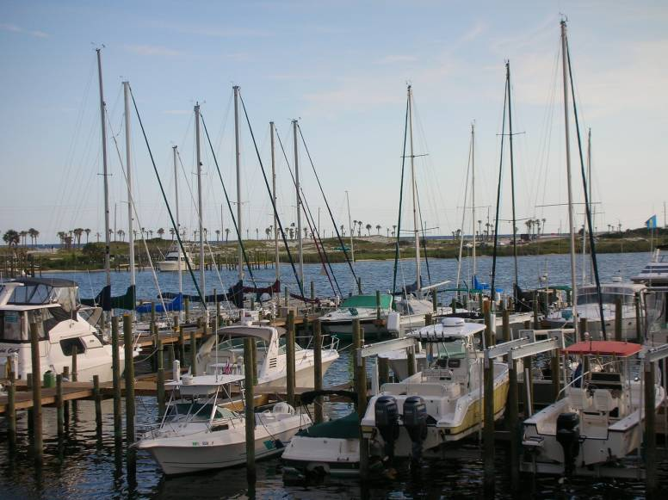
Ivan: Pre-Storm Marina
Remember this image

Slide 7
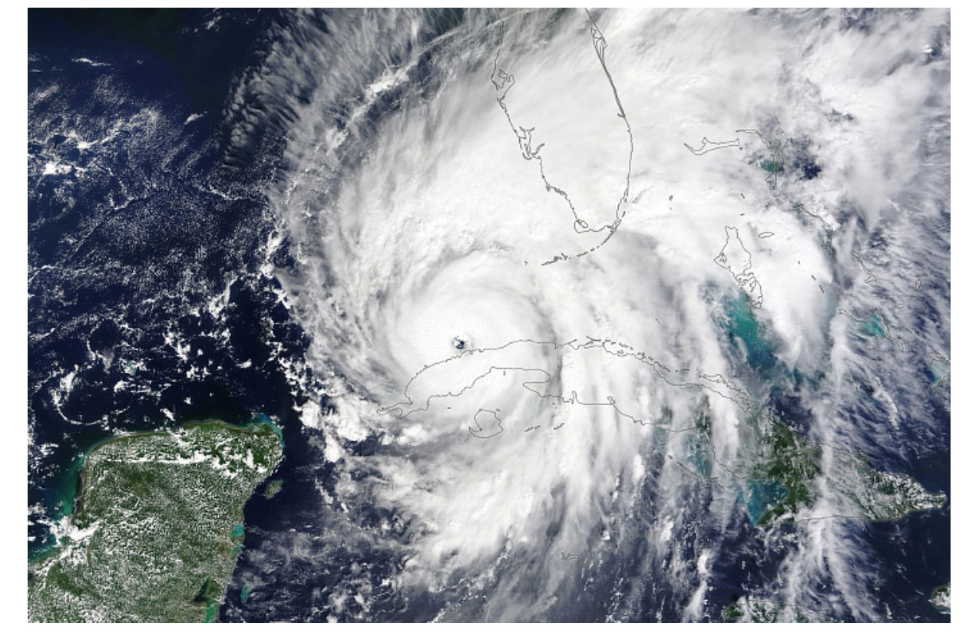
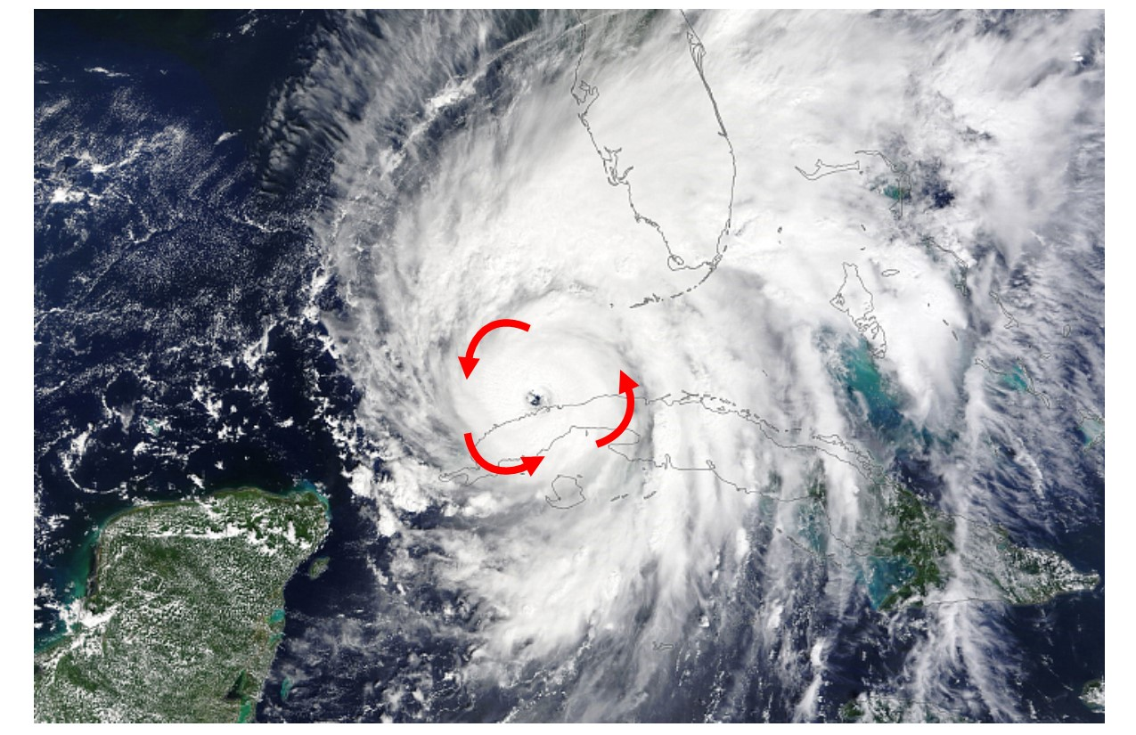
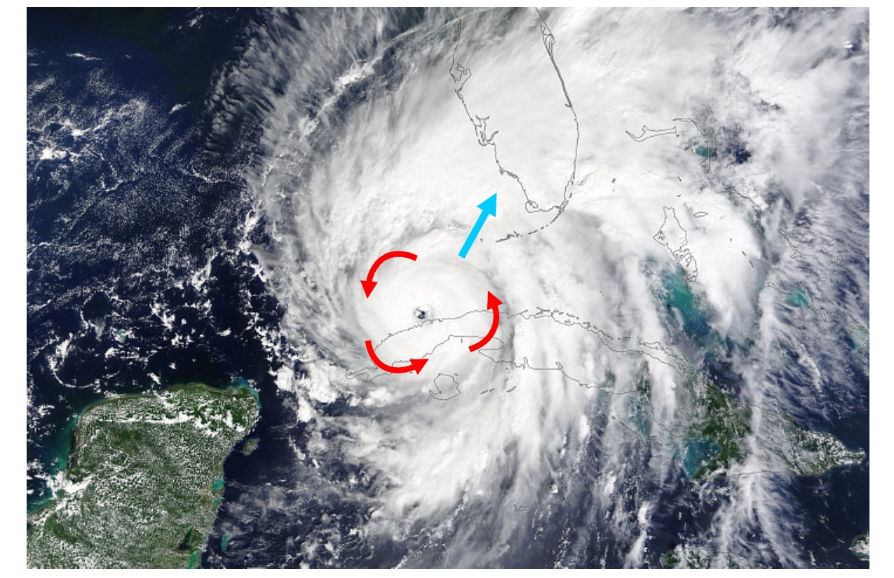
Hurricane Characteristics: Winds
Notes:
Hurricane Ian – satellite view
Winds around the eye: most intense in the eyewall
Winds with travel of hurricane
Winds on right side = rotational winds plus travel speed. Example: 120mph rotational wind plus 15mph travel speed = 135mph winds.
Winds on left side = rotational winds minus travel speed. Example: 120 mph rotational wind minus 15mph travel speed = 105mph winds.

Slide 8
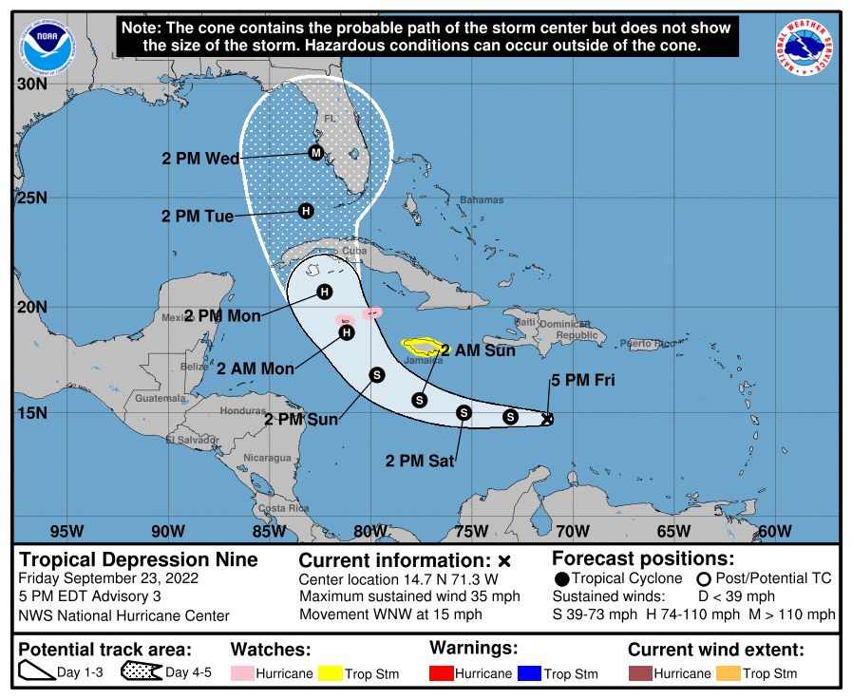
Hurricane Characteristics: Winds
Notes:
What this means is that if you are on the right side of the track, the winds you experience will be the highest: rotational plus travel
Winds on the left side of the track will be lower: rotational minus travel

Slide 9
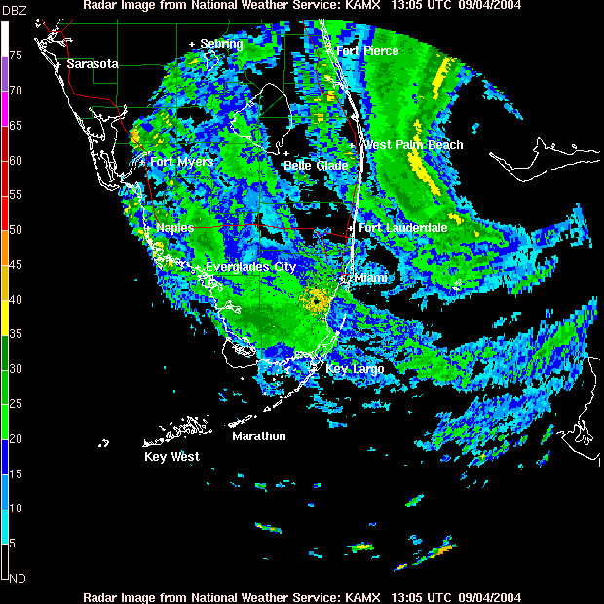
Hurricane Characteristics: Winds
Notes:
Wind Direction:
Depends upon where you are relative to the eye.
North of the eye: winds will start out from the north, change to east, then southeast.
Center of eye: winds will start from the north, the eye passes, then from the south
South of the eye: winds start from the northwest, change to west, then from southwest

Slide 10
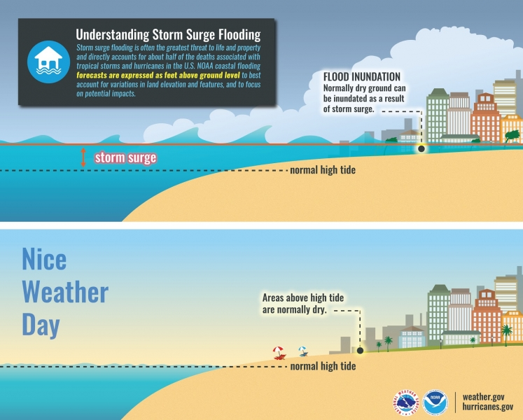
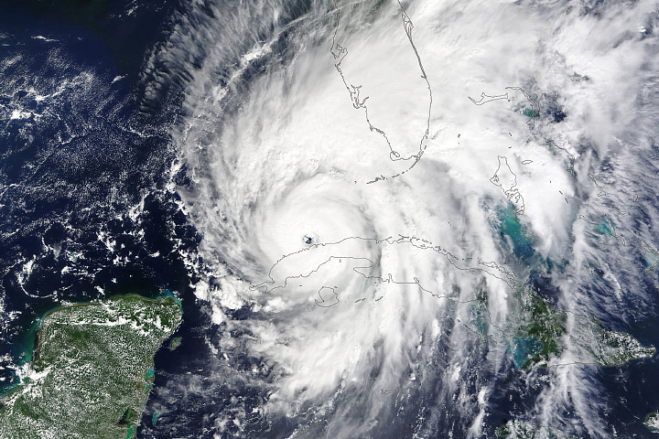
Hurricane Characteristics: Storm Surge
Notes:
Winds around hurricane push water ahead: storm surge
Storm surge is on top of normal tides.
Plus wind-generated waves on top of the surge, perhaps 20 – 30 ft
Jupiter Lighthouse base is about 48ft above the water; for a Cat 5 storm, the base will likely be getting wet.
This is what storm surge looks like

Slide 11
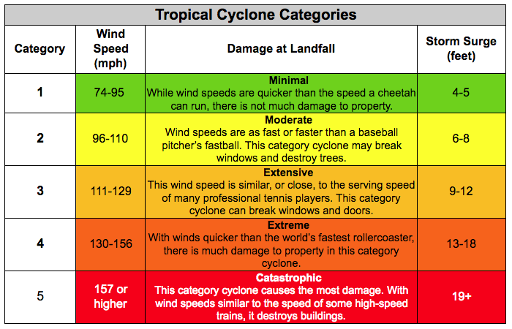
Hurricane Characteristics: Storm Surge
Notes:
Winds around hurricane push water ahead: storm surge
Storm surge is on top of normal tides.
Plus wind-generated waves on top of the surge, perhaps 20 – 30 ft
Jupiter Lighthouse base is about 48ft above the water; for a Cat 5 storm, the base will likely be getting wet.
This is what storm surge looks like

Slide 12
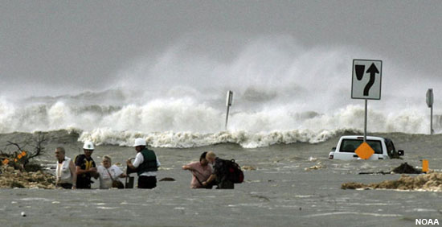
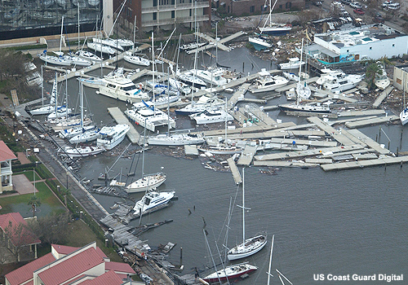
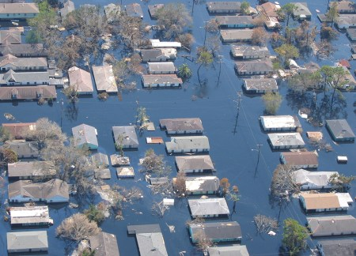
Hurricane Characteristics: Storm Surge
Notes:
This is what storm surge looks like

Slide 13
Hurricane Preparation
How can we prepare our boats to survive this?
By planning ahead and taking early action.
Notes:
We’ll discuss insurance and legal issues later. After every storm insurance companies and state legislatures appear to “change the rules!”
For example, following the 2006 hurricane season the Florida Legislature amended laws affecting all recreational boats, dockage and mooring rules, and insurance. Remember the “old saw” – Prior Planning Prevents Poor Performance. Preparing for tropical storms requires significant and detailed planning.
Things to consider:
Where to go – preferably inland in protected waters such as ICW, rivers, or small bayous.
Hauling vessel out of water – Where, cost, certifications, emergency response, suitable cradles/stands, damage that may prohibit re-launching.
Locations for moorings – Cost, safety, can vessel be checked if necessary.
Long distance evacuation plans should include appropriate pre-emergency transportation back to residence.
Hurricane holes:
Well inland and protected. Map study; then visit by water and land.
At least one angle or bend to slow storm surge.
Firm or sandy bottom – muck doesn’t hold anchors well.
Easy access and room to maneuver.
At least five to seven foot of water under your keel. More is better.
Adequate tie-offs or mooring points.
Swing room if storm anchored and not tied-off.
After the storm will you be able to recover your boat.
Remember – he who gets there first gets the best position.
Every time you visit or use your boat you need to assess conditions for future storm related solutions. If something changes, even fuel on-board, how will it affect your storm plan. Plan for what will happen if you can not get back to your boat.
Absentee owners:
Some one must be you agent and be responsible for your storm preparations.
Who has the keys and authority to move and secure your boat?
Have you prepared written instructions? Does the state require a power of attorney.
How will you pay for required services?
Finding a responsible party or captain may be difficult if you wait until storm season. Ask at your marina, dockyard, boat dealer. Another USPS or USCGA member may know of a competent captain. Does your captain need a USCG license?

Slide 14
Hurricane Preparation (Prior to May)
Check vessel & gear
Review Marina Contract; speak w/ Dockmaster
Make plan (trailer/haul/hole)
Check trailer (repair if necessary)
Check with Marine-ways (“Hurricane Policy”)
Select “Hurricane Holes” (at least three in each direction)
Visit each with your vessel frequently looking for changes and problems
***Absentee owners: Hire dependable captain and sign a detailed contract
Notes:
We’ll discuss insurance and legal issues later. After every storm insurance companies and state legislatures appear to “change the rules!”
For example, following the 2006 hurricane season the Florida Legislature amended laws affecting all recreational boats, dockage and mooring rules, and insurance. Remember the “old saw” – Prior Planning Prevents Poor Performance. Preparing for tropical storms requires significant and detailed planning.
Things to consider:
Where to go – preferably inland in protected waters such as ICW, rivers, or small bayous.
Hauling vessel out of water – Where, cost, certifications, emergency response, suitable cradles/stands, damage that may prohibit re-launching.
Locations for moorings – Cost, safety, can vessel be checked if necessary.
Long distance evacuation plans should include appropriate pre-emergency transportation back to residence.
Hurricane holes:
Well inland and protected. Map study; then visit by water and land.
At least one angle or bend to slow storm surge.
Firm or sandy bottom – muck doesn’t hold anchors well.
Easy access and room to maneuver.
At least five to seven foot of water under your keel. More is better.
Adequate tie-offs or mooring points.
Swing room if storm anchored and not tied-off.
After the storm will you be able to recover your boat.
Remember – he who gets there first gets the best position.
Every time you visit or use your boat you need to assess conditions for future storm related solutions. If something changes, even fuel on-board, how will it affect your storm plan. Plan for what will happen if you can not get back to your boat.
Absentee owners:
Some one must be your agent and be responsible for your storm preparations.
Who has the keys and authority to move and secure your boat?
Have you prepared written instructions? Does the state require a power of attorney.
How will you pay for required services?
Finding a responsible party or captain may be difficult if you wait until storm season. Ask at your marina, dockyard, boat dealer. Another USPS or USCGA member may know of a competent captain. Does your captain need a USCG license?

Slide 15
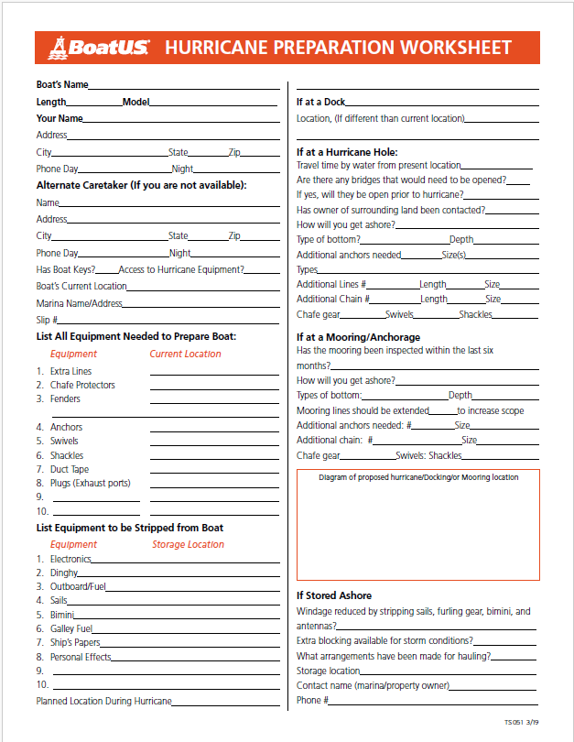
Storm Plan – Do It Now!
Prepare a storm plan such as this one from BoatU.S.
Answering all the questions is a start
Notes:
Storm Plan ……DO IT NOW!
To do:
Batteries.......………charge them
Bilge.……………..…clean / clear limber holes
Bilge pumps ……….test pumps / switches
Cleats................…....bigger, backed and reinforced
Cockpit drains.….....clear
Fuel tanks…………..fill them
Water tanks.........….empty them
Remove:
Deck gear – anything not bolted down
Cowl ventilators
All electronics
All ships papers / log
All fuel, oil, solvents etc, not in permanent tanks
All personal property
Cabin gear – anything that can be stored in a dryer/safer place

Slide 16
Approaching Storm
Actions:
Batteries…………….charge them
Bilge…………………clean / clear limber holes
Bilge Pumps………..test pumps / switches
Cleats……………….bigger, backed and reinforced
Cockpit Drains……..clear
Fuel Tanks………….fill them
Water Tanks………..empty them
Notes:
Storm Plan ……DO IT NOW!
To do:
Batteries.......………charge them
Bilge.……………..…clean / clear limber holes
Bilge pumps ……….test pumps / switches
Cleats................…....bigger, backed and reinforced
Cockpit drains.….....clear
Fuel tanks…………..fill them
Water tanks.........….empty them
Remove:
Deck gear – anything not bolted down
Cowl ventilators
All electronics
All ships papers / log
All fuel, oil, solvents etc, not in permanent tanks
All personal property
Cabin gear – anything that can be stored in a dryer/safer place

Slide 17
Approaching Storm
Remove:
Deck gear – anything not bolted down
Cowl ventilators
All electronics
All ships papers / log
All fuel, oil, solvents, etc. NOT in permanent tanks
All personal property
Cabin gear – anything that can be stored in a dryer/safer place
Notes:
Storm Plan ……DO IT NOW!
To do:
Batteries.......………charge them
Bilge.……………..…clean / clear limber holes
Bilge pumps ……….test pumps / switches
Cleats................…....bigger, backed and reinforced
Cockpit drains.….....clear
Fuel tanks…………..fill them
Water tanks.........….empty them
Remove:
Deck gear – anything not bolted down
Cowl ventilators
All electronics
All ships papers / log
All fuel, oil, solvents etc, not in permanent tanks
All personal property
Cabin gear – anything that can be stored in a dryer/safer place

Slide 18
Approaching Storm
Potential actions to prepare for a storm event:
Duct tape…………………….seal everything
Plugs…………………………for exhaust outlets
Chafing gear…………………anywhere your lines touch anything
Heavy lines………………….double all lines
Fenders………………………tires / fender boards
Ground tackle / Anchor / Chain……2 (minimum)
Take a weather course…….the knowledge may save your life, property and boat
Ask your insurance company for their recommendations
Notes:
As a recreational boater you need to be aware to the potential actions needed to prepare for a storm event.
Duct tape …………. seal everything
Plugs ……………… for exhaust outlets
Chafing Gear …….. anywhere your lines touch anything
Heavy Lines ……… double all lines
Fenders …………… tires / fender boards
Ground Tackle / Anchor / Chain …. 2 (minimum)
Take a weather course – knowledge may save your life, property and boat.
You also need to know what not to do!
Remember, trying to sail or move your boat is also a dangerous option if you are trying to outrun a storm.
Ask your insurance company for their recommendations!
Check online sources and the references with this seminar.

Slide 19
Approaching Storm
What not to do:
Trying to sail or move your boat is also a dangerous option if you are trying to outrun a storm.
Notes:
As a recreational boater you need to be aware to the potential actions needed to prepare for a storm event.
Duct tape …………. seal everything
Plugs ……………… for exhaust outlets
Chafing Gear …….. anywhere your lines touch anything
Heavy Lines ……… double all lines
Fenders …………… tires / fender boards
Ground Tackle / Anchor / Chain …. 2 (minimum)
Take a weather course – knowledge may save your life, property and boat.
You also need to know what not to do!
Remember, trying to sail or move your boat is also a dangerous option if you are trying to outrun a storm.
Ask your insurance company for their recommendations!
Check online sources and the references with this seminar.

Slide 20
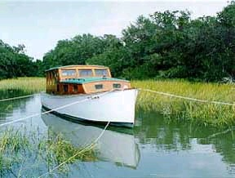
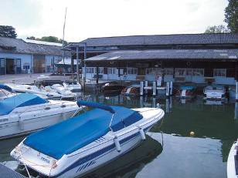
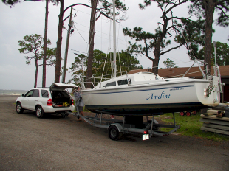
Approaching Storm
Act early!! The best spots fill up quickly
Drawbridges lock down before the storm arrives
Partnerships with others are helpful
Don’t wait until you are working in bad weather
Notes:
Plan ahead! Most local boaters know where the best hurricane holes are located and the smart ones act early.
Possible preparation partners:
Neighbors and family with boats working together.
Marina – boat owners and marina staff working as a team will get more done faster.
Yacht club – most will have a hurricane/storm plan and teams of members to move, moor and secure member and club boats.
Boat yards – hauling capability. Blocking and land storage. You may need a contract and priority for hauling.
Community and government resources (interest is in protecting public resources).
Church and civic organizations.
Maritime businesses – self-preservation and helping keep your boat from causing them damage.
Sea Scout ship needing assistance and then assisting others.
Man Power and similar worker resources where you can “rent” assistance.
If your boat is trailerable to best bet is to take it out of danger.
Small boats may weather the storm better if blocked on trailers, strapped down, and covered. Some skippers have found that boats without internal engines can be weighted down by filling with water. This can only be done if the water will not damage the boat.
Moving your boat is much easier if you team up with other boaters. One skipper with several helpers can work faster and efficiently anchor and secure a boat. Then they can move on to assist other skippers. When done securing the boats, the skippers and helpers need to dingy or boat out of the hurricane hole before weather conditions deteriorate or become hazardous.

Slide 21
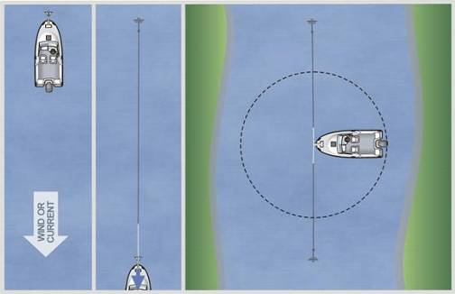
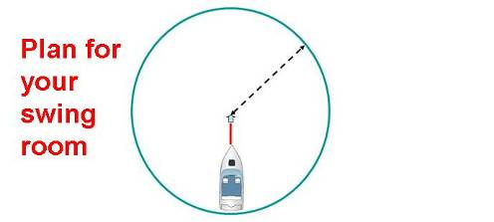
Hurricane Hole
Protection from wind
Suitable water depth
Good holding ground (verify!)
Adequate room to swing
Notes:
If you can not trailer your boat out of the impact zone a good hurricane hole may be the immediate answer. Early, early access is critical – don’t wait for a better time.
There must be sufficient depth to allow for the vertical displacement due to storm surge followed by return to a potentially lower depth in a confined space. Many boats are damaged by hitting bottom as the surge goes out.
The ground has to be sufficient to hold the anchor(s) without dragging or breaking free.
Anchoring requires that you determine the amount of swing room. This is even more critical if several boats are anchored in the same area.
Consider how you will after the storm get your boat out of the hurricane hole. This may not be easy!

Slide 22
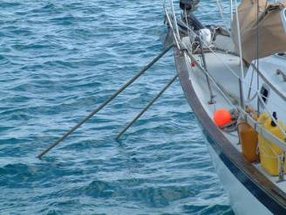
Hurricane Anchoring
Increase anchor line size
Double chafing gear and sacrifices
20 to 40 ft. chain
Safe depth plus twice expected storm surge.
10:1 scope minimum
30 deg.
Sentinel
No more than 8 deg. horizontal rise in anchor chain
Notes:
Two heavy duty storm anchors forward. In areas with a strong reverse surge occurs an aft anchor may be needed.
Select a protected anchorage early.
Basic mooring or anchoring standards:
Double braid or triple twist nylon – 3/4” – 1.5”
Chaffing gear – i.e. fire hose minimal requirement (check with your local fire department for salvage hose that you can use)
Double mooring lines
Redundant safety lines for each mooring point
Double or triple anchoring
Mooring point clean up

Slide 23
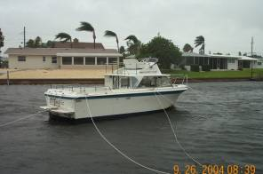
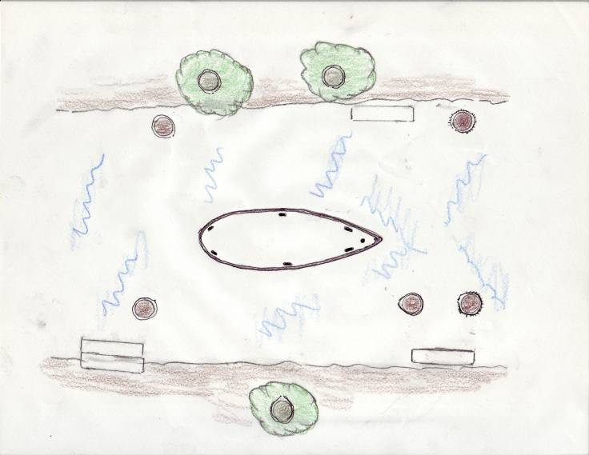
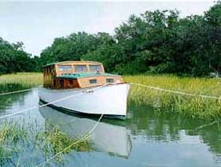
Storm Ready
Chaffing Gear or Tide Rollers on Pilings if they are high enough
Surge
Anchor Line
Use rooted trees not Palms
Notes:
Once you’ve found a good anchorage turn your boat into the direction from which the primary wind or storm surge will come and set your storm anchor.
Then using heavy line preferably with splices or seized eyes to limit the use of entangling knots secure the boat to stable pilings or moorings.
If there are no adequate tie-offs (pilings, dockage, etc.) consider turning several helical anchors if they are locally permitted (remember you have to remove them after the storm).
Trees can be good tie-offs if they have mature root systems and six inch or larger trunks.
Palm trees have very weak root systems and should not be used for securing your boat.
All rub and wear points should be reinforced with chaffing gear.
If there are pilings higher than the expected storm and tide surge tide rollers (little wheels) on the lines may move up and down the pilings.
Depending on location and type of mooring(s) fenders may be useful protection.
General Considerations:
Center in waterway – face oncoming storm (if possible)
Double-up lines – Orient 45 degrees off bow and stern
Longer lines and distances to anchorages are preferred
Use newest and largest lines as primary gear
Use older lines only as back-up doubling lines
Tie to Substantial Anchors (trees, pilings, ground anchors)
Use Multiple Attachment Points – Both on boat and on land
Tie: High on Pilings - Low on Trees

Slide 24
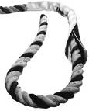
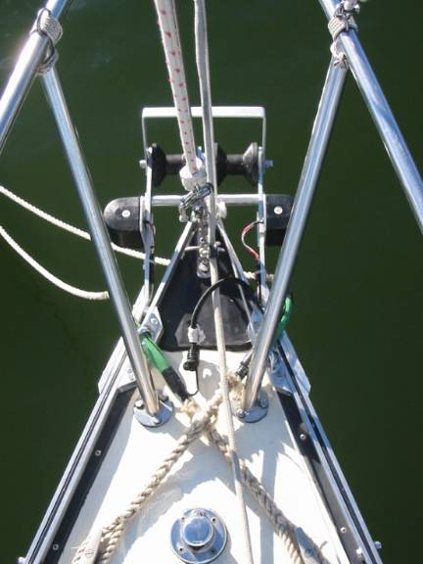
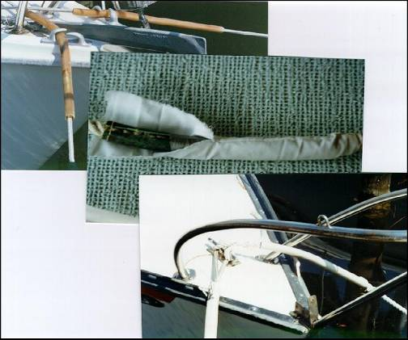
Chafing Gear
Notes:
Chaffing gear can be purchased or homemade.
Wrap line with rubber hose and seize or whip in place. Cover the hose with canvas that will act as a lubricant allowing line to slide on or through tackle.
On larger line old fire hose makes excellent chaffing gear.
Be careful not to have chaffing gear that is snug against the protected line. Recent analysis of line failure indicates that excess internal heat may be causing line failure.

Slide 25
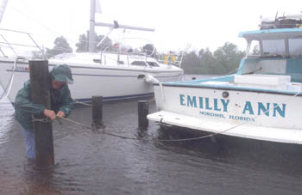
How Long?
Prepare boat ……………………….... 6 hrs
Move boat to hurricane Hole ………4 hrs
Travel time – to ramp & return …… 2 hrs
Prepare Home for storm ………… 8 hrs
Pickup emergency supplies …….... 4 hrs
Evacuate to Safe Shelter ………...….8 hrs
Murphy Contingency …….……….. 8 hrs
Total: 40
[ Daylight Hours ]
Notes:
It will take longer than your believe to prepare your boat to ride out a storm.
If you live in an area with draw brides or commercial fairways, etc., there will be a must precede bridge or waterway lockdown time.
Remember Murphy – if something can go wrong it will!

Slide 26
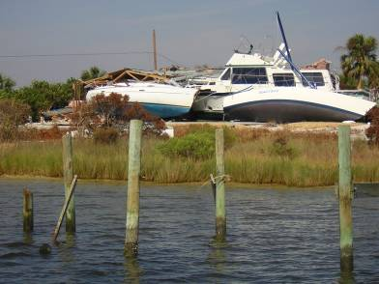
You are responsible
Irresponsible owners
Cause serious problems for recreational boaters
Can’t be forced to leave a marina dock
Pay for damages
Coastal states laws affects
Delays by local authorities
What can go wrong???
Notes:
Remember Murphy – if something can go wrong it will. And you may be holding the bag.
Irresponsible vessel owners create a hostile political environment
For example: Florida HB7175
Serious changes for recreational boaters
Can’t be forced to leave a marina dock but you may have to pay for damages
Most coastal states have laws that affect you in terms of anchoring, dockage and damages.
Local government authorities may not react early enough to be of help in your decision processes. Frequently local authorities delay out of fear of being liable for adverse financial results.
What can go wrong??? Murphy - If something can go wrong it will. Especially in terms of tropical storms, Murphy – was an optimist!

Slide 27
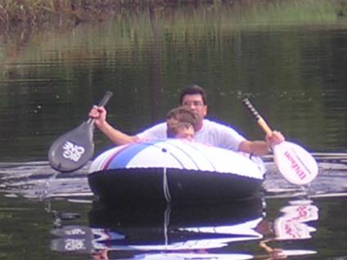
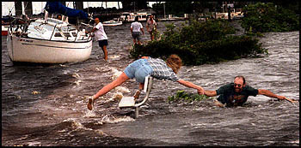
Post Storm Recovery and Rescue
Notes:
This may look silly but post storm resources, recovery and rescue may demand ingenuity – or stupidity. These are very hazardous things to do considering the debris, contamination, and dangerous wildlife.
Personal safety must always be considered! This is also not the time to forget the PFDs you saved before the storm.

Slide 28
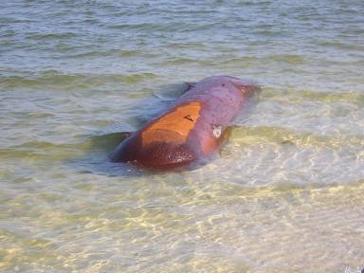
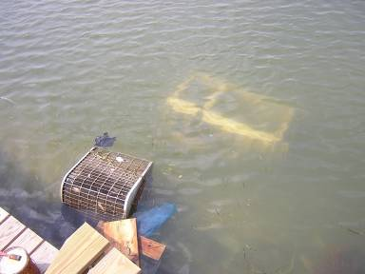
Obey USCG Waterways Closures
Post-hurricane efforts focus on commercial traffic (e.g., gasoline)
Law enforcement efforts
Don’t become a problem
Propane Tank
AC and Refrig.
Notes:
In most cases the waterways will be opened only for emergency commercial and rescue vessels.
The USCG will emergency mark commercial channels essential for recovery. However, it does not mean the channels are cleared.
Let post-hurricane efforts focus on re-establishing commercial traffic (e.g., gasoline)
Law enforcement can better deal with the criminals if the non-criminals aren’t in the way
Don’t become a drain to rescue/recovery personnel by needing rescue/assistance.
Large items – A/C and refrigerator. Even houses. This type of debris may never be mapped or removed!

Slide 29
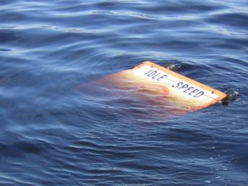
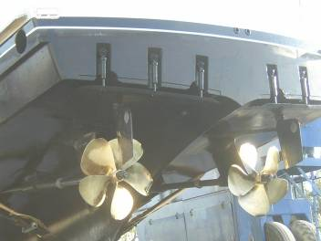
When Waterways Re-open:
Use extreme caution!!
Navigation Aids moved / missing
Submerged/floating debris
Shoaling; channel changes
Floating debris
Report hazards
Use “Vessel Lost & Found”
Notes:
As recreational boaters we have no priority and may be viewed as a dangerous nuisance.
Use extreme caution!! Only federal channels are (or will be) cleared. The purpose of clearing is to begin recovery operations and movement of critical resources such as gas and oil.
Navigation Aids damaged/destroyed/moved and until surveyed they are not reliable.
Submerged/floating debris hard to see
Shoaling; channel changes the USCG and USA COE must chart and survey navigation channels.
Floating debris can create hazards in areas previously “clear.” Past knowledge can not be trusted. Moving your boat before the area is clear may result in serious damage.
Boat damage – props, shafts, bearings, rudders and trim tabs. Owner ignored instructions to stay at anchor. Insurance company has rejected claim for damages based n owner negligence.
Report hazards (include description & Lat/Lon) to the USCG reporting center.
Use state “Vessel Lost & Found” (in Florida 888-call-FWC) to report and locate missing boats. USCG may maintain a separate list but takes longer to access.

Slide 30
Remember this Marina?
Notes:
Two days before – no plan evident. Look at all the canvas and flags. A number of these vessels are trailerable.

Slide 31
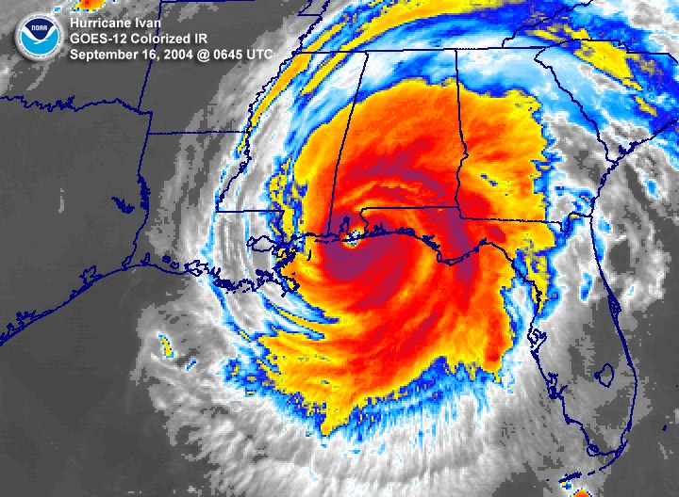
Along came Ivan
Notes:
Remember Ivan

Slide 32
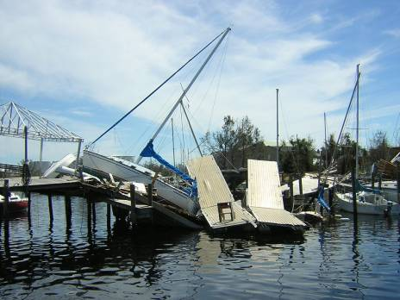
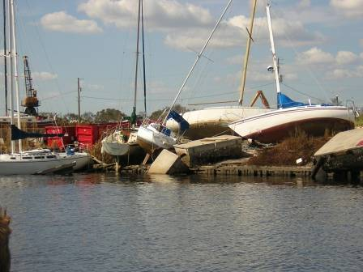
And the Marina Became
Notes:
Some dock sections stayed in place and some moved. Several vessels do not appear rigged for the storm nor is it evident that the mooring lines were long enough to accommodate the storm surge break free.
Vessels left tied to floating docks may be at greater danger of storm surge damage as docks also break free.
Note the sails and canvas not removed indicating that these vessels were not prepared for the storm by their owners.

Slide 33
Lessons Learned from Storms
Barrier Islands are only speed bumps for large waves riding atop storm surge
Bayous and canals get very crowded
One inadequately anchored vessel can cause a lot of damage
Nowhere is safe, but some places are better than others
Notes:
Learn from other boater’s examples:
Barrier Islands are important in that they serve a distinct purpose. Barrier islands function as shock absorbers for the mainland and as nice scenery. Surge waves washing over the islands move large volumes of sand into bayous, bays and waterways.
Prior to storm onset the protected bayous become very crowded. Navigation and maneuvering is challenging and potentially dangerous.
A single vessel dragging its anchor or breaking free can cause significant damage to many other vessels.
A studious map study and pre-storm survey may identify a potentially suitable hurricane hole.

Slide 34
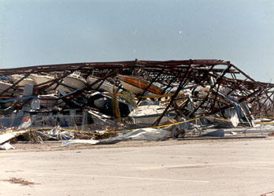
Dry Storage
Not designed for storms
Notes:
Hopeless! Be sure your Insurance is paid up!
Under no circumstances should you leave your boat stored in a dry stack unless the stack is rated for winds in excess of 150mph!
They are likely to fold up and damage or destroy every boat!

Slide 35
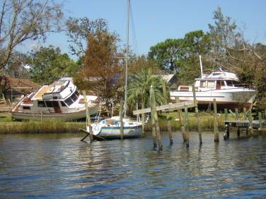
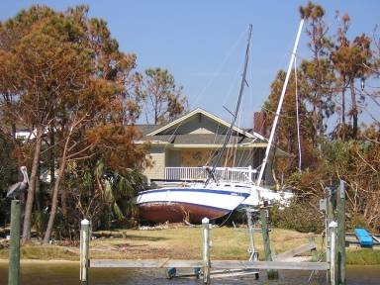
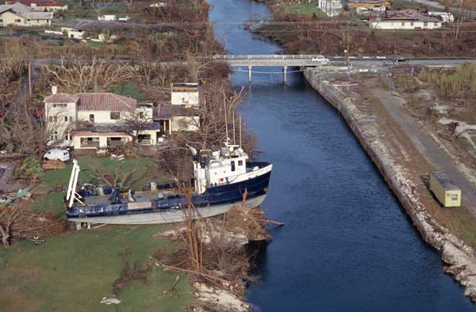
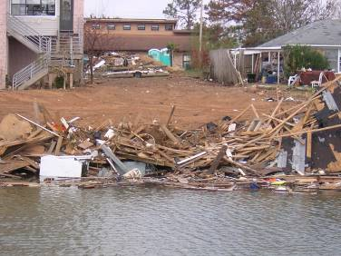
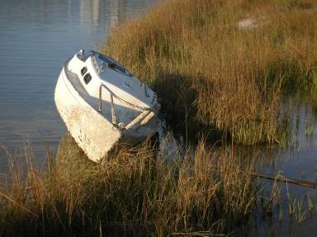
In Yards
Notes:
Note the condition of the house and the use of hurricane shutters.
Larger boats broke loose but a well prepared sailboat held in place with little damage. Not visible in the photo are the heavy duty lines and extra chaffing gear used on the sailboat. The grounded vessels line remnants were too light for storm use and anchor rodes were good for average use but not a storm surge and broke.
Boats in wetland are problems a permit may be required to remove or may require an expensive helicopter lift out.
Most of the debris came off a barrier island to the mainland. Property owners and insurance companies may reject cleanup responsibility. At the same time these pose hazards for boaters.

Slide 36
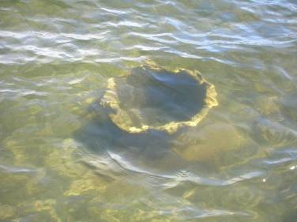
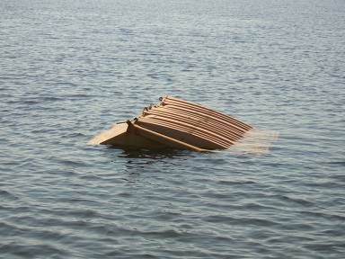
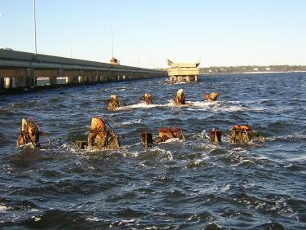
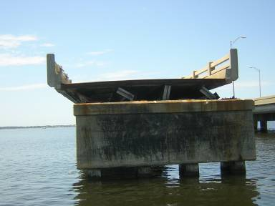
Heavy Debris
Truck Transmission
Large Dumpster
Bridge Pilings
Bridge gone
Notes:
Under three feet of water adjacent to a navigation channel. Normally 4 to 5 feet of water crossed by many small boats.
This truck transmission weighs nearly 400 pounds.
Dumpsters and Conex containers abound in the post storm waterways.
Bridges washed away leaving pilings and debris underwater. The bridge debris may be some distance from the original location.
These are good reasons not to hurry to move your vessel before adequate mitigation or debris surveys.

Slide 37
Separated Dockage
Notes:
In the water and onshore typical hazards. Is your shot series up to date? Heavy duty footwear is essential!
Also be a good neighbor and safely remove these hazards to a pickup pile.
Note: Storm damage to docks is generally viewed as “An Act of God” and not covered by insurance.

Slide 38
The Mast Marks the Spot
Notes:
Sunken boats are a major problem. Be careful, if your insurance company pays you off you remain liable for the salvage removal of the boat and hazardous materials.
The owner is responsible for salvage of his property. But insurance companies concerns may also prevent rapid removal. Before jumping in to clear abandoned vessels check the law! In some states this can be a difficult and time consuming process. At the same time you can not abandon your responsibility to remove your vessel.
Navigation hazards (in charted channels) will get attention first. These hazards to storm recovery may be removed by local or USCG action. The owner may be billed for the removal costs.

Slide 39
Waterway Restoration
Notes:
Local, State and Federal authorities may not clear many waterways.
Some localities have prepared plan as to what waterways will be surveyed and the order for restoration.
Check for maps in your locality – if your hurricane hole is in an area that will not be cleared you may not be able to recover your boat.
Many waterways will not be restored.

Slide 40
Insurance
Check carefully your boat insurance!
What is reasonable action following the storm?
After Katrina there were major changes and restrictions affecting recreational boaters
Many boaters are foregoing insurance and this may increase your liability and hazard
Notes:
If you live in coastal areas you most likely have already heard from your insurance agent. Your insurance company wants to know that you take every reasonable precaution to protect your vessel and reduce liability and claims.
A growing number of boaters are not insuring their boats or can not acquire insurance depending on vessel type, age, size, and location. This may increase your liability concerns in the event of a storm.
You must take “reasonable” action to prevent further loss / damage
Return when prudent and access is allowed
Submerged Engines:
Outboards
Gas Inboard
Diesel Inboards
Generators
Generator engines may be restored, but electrical generators are not repairable
Advise insurer if circumstances prevent taking reasonable action

Slide 41
Key Points
Develop your hurricane plan early.
Make all arrangements for moving and securing your vessel prior to hurricane season.
There are insufficient safe havens. Act early!
Do not stay on your vessel, or try to move or secure it after small craft warnings are issued.
Notes:
Develop your hurricane plan early. Knowing what and when to act is important – once the advisory is issued is not the time to buy line or anchors since they may be sold out.
Make all arrangements for moving and securing your vessel prior to hurricane season. If you need to be lifted out the marina may not have time if you have not made prior arrangements. You may find your trailer is not ready for the load and road.
There are insufficient safe havens. Act early! Like birds, the early boater gets the best anchorage or hurricane hole.
Do not stay on your vessel, or try to move or secure it after small craft warnings are issued. Trying this may make you one of the 25% of the injuries and deaths due to major storms.

Slide 42
Key Points II
Don’t be fooled by the lull or calm as the storm eye passes. The second half will soon strike.
Stay tuned to official bulletins. Don’t return to your vessel until told it is safe to do so.
Vessels that sink during a storm are not considered boating accidents.
Notes:
Don’t be fooled by the lull or calm as the storm eye passes. The second half will soon strike. Too frequently storm survivors leave shelter to see what has happened only to be caught by the next wave of severe weather and flying debris.
Stay tuned to official bulletins. Don’t return to your vessel until told it is safe to do so. Rumor will abound, local state and federal emergency management officials will advise when it is safe to move about. The National Hurricane Center bulletins are the best source of storm movement and dangers.
Vessels that sink during a storm are not considered boating accidents. An accident report is not necessary but you may want to request a state of police Owner’s Report Form for an insurance damage claim.

Slide 43
Key points III
Sunken vessels must be removed from the water. Do not abandon a sunken vessel.
Your life is more valuable than your property. Do not allow yourself to become a hurricane statistic!
Notes:
Sunken vessels must be removed from the water. Do not abandon a sunken vessel.
Your life is more valuable than your property. Do not allow yourself to become a hurricane statistic!

Slide 44
End
Questions?
Katrina

Slide 45
References
Hurricane Manual for Marine Interests, Escambia County Department of Public Safety, FL, 2006
Marine Hurricane Information, Florida Marine Insurance Agency, 2000
Hurricane Warning, BoatUS, 2005
Rough Weather Seamanship, Marshall, R., McGraw-Hill
www.nhc.noaa.gov/HAW2/english/maine_safety.shtml
www.boatsafe.com/nauticalKnowHow/6198tip2.htm
www.lsuagcenter.com/environmental/fisheries/recreation+your+boat+during+hurricane
Manatee Sail & Power Squadron Hurricane Team

